Slide 1
Identifying Cross-Disciplinary
Pathways to Translational Science
Griffin M Weber, MD, PhD
Head of the Knowledge Discovery and Management Group
Center of Biomedical Informatics; Harvard Medical School; Boston, MA, USA.
Department of Medicine, Beth Israel Deaconess Medical Center; Boston, MA, USA. weber@hms.harvard.edu
Nick Benik, Nick Brown, Ken Huling,
Marlon Violette, James Norman, Steve Wimberg

Slide 2
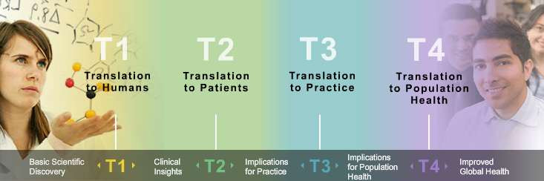
Translational Science
Image from http://catalyst.harvard.edu
T1-T4 is qualitative, no consensus on precise definition.
Can a bibliometric technique quantitatively identify translation?
Weber GM. Identifying translational science within the triangle of biomedicine. J Transl Med. 2013 May 24;11:126. doi: 10.1186/1479-5876-11-126.
http://www.ncbi.nlm.nih.gov/pmc/articles/pmid/23705970

Slide 3
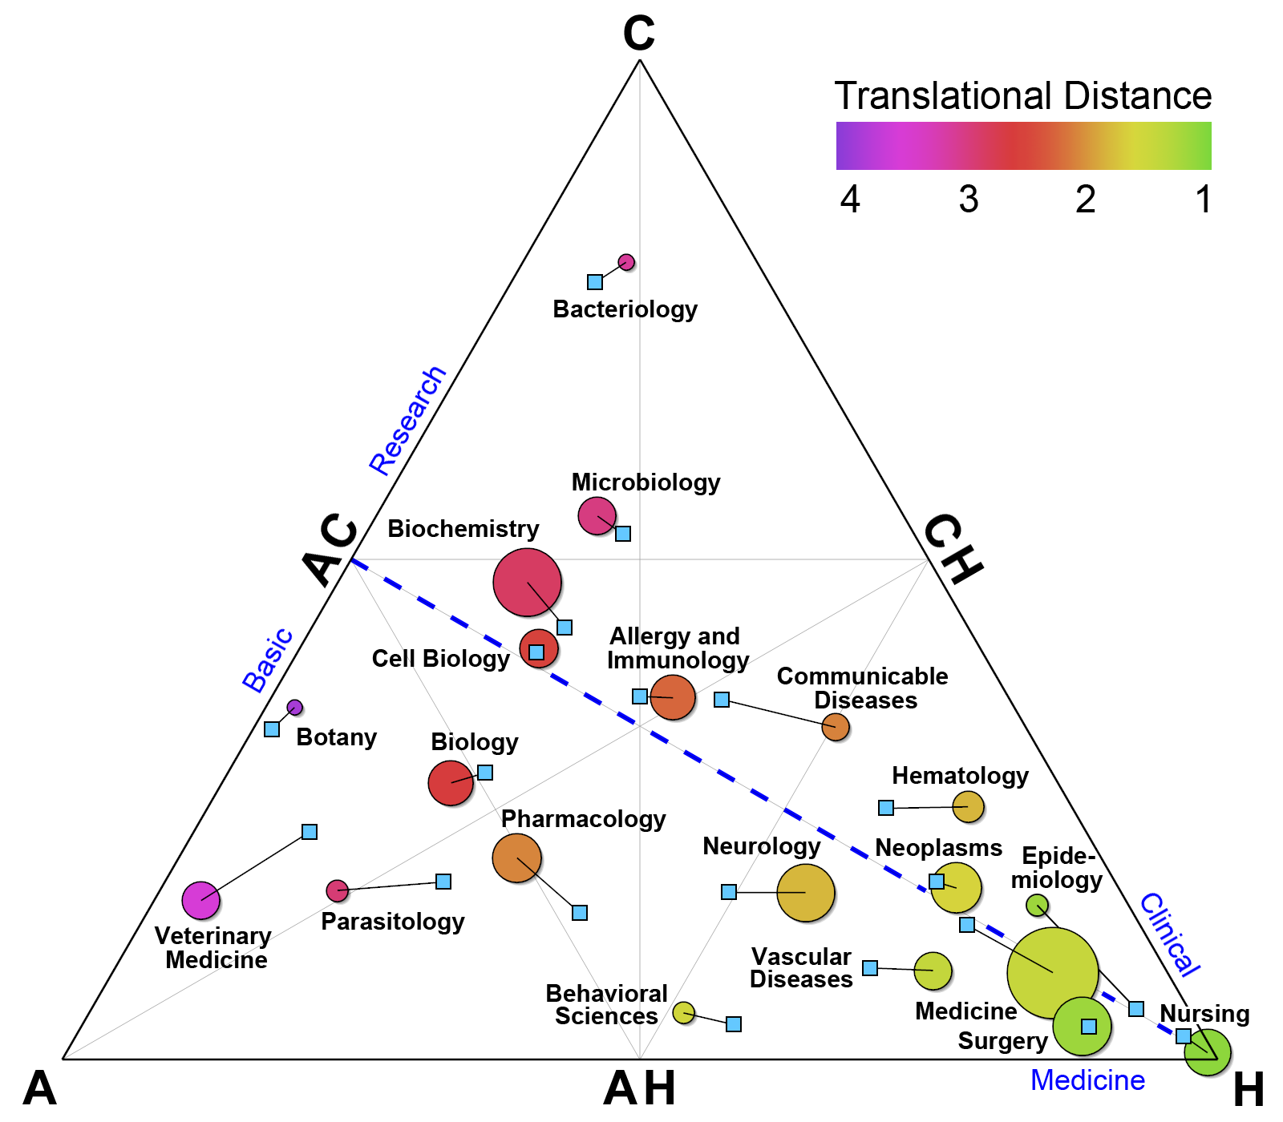
Triangle of
Biomedicine
“C”: Cells & Molecules
“A”: Animals
“H”: Humans
Weber GM. Identifying translational science within the triangle of biomedicine. J Transl Med. 2013 May 24;11:126.

Slide 4
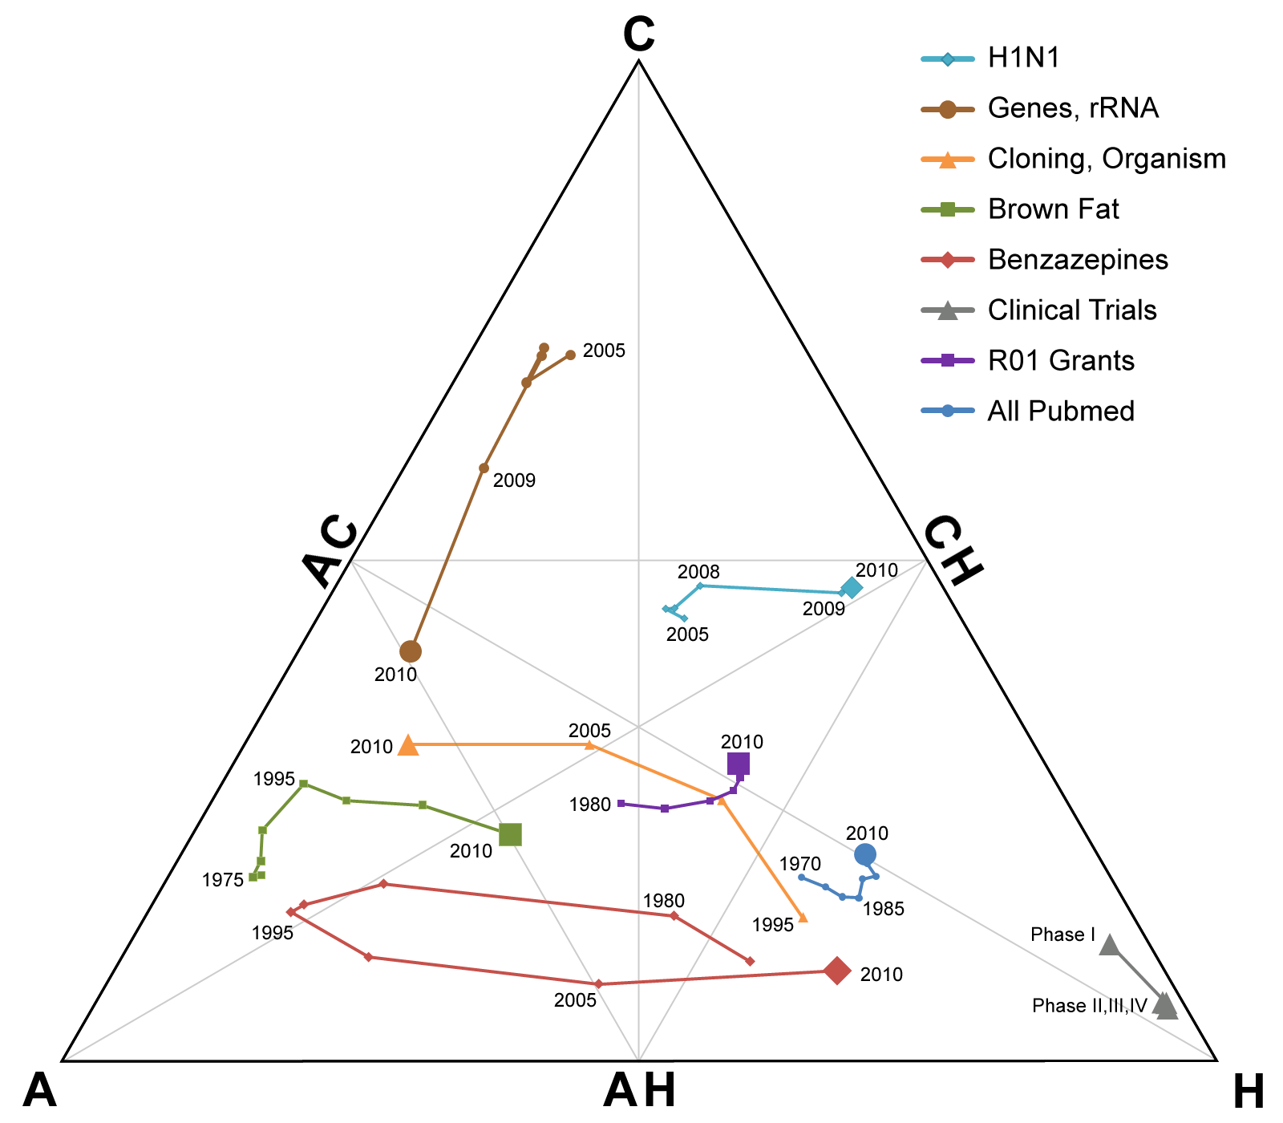
Triangle of
Biomedicine
“C”: Cells & Molecules
“A”: Animals
“H”: Humans
Trends Over Time
Weber GM. Identifying translational science within the triangle of biomedicine. J Transl Med. 2013 May 24;11:126.

Slide 5
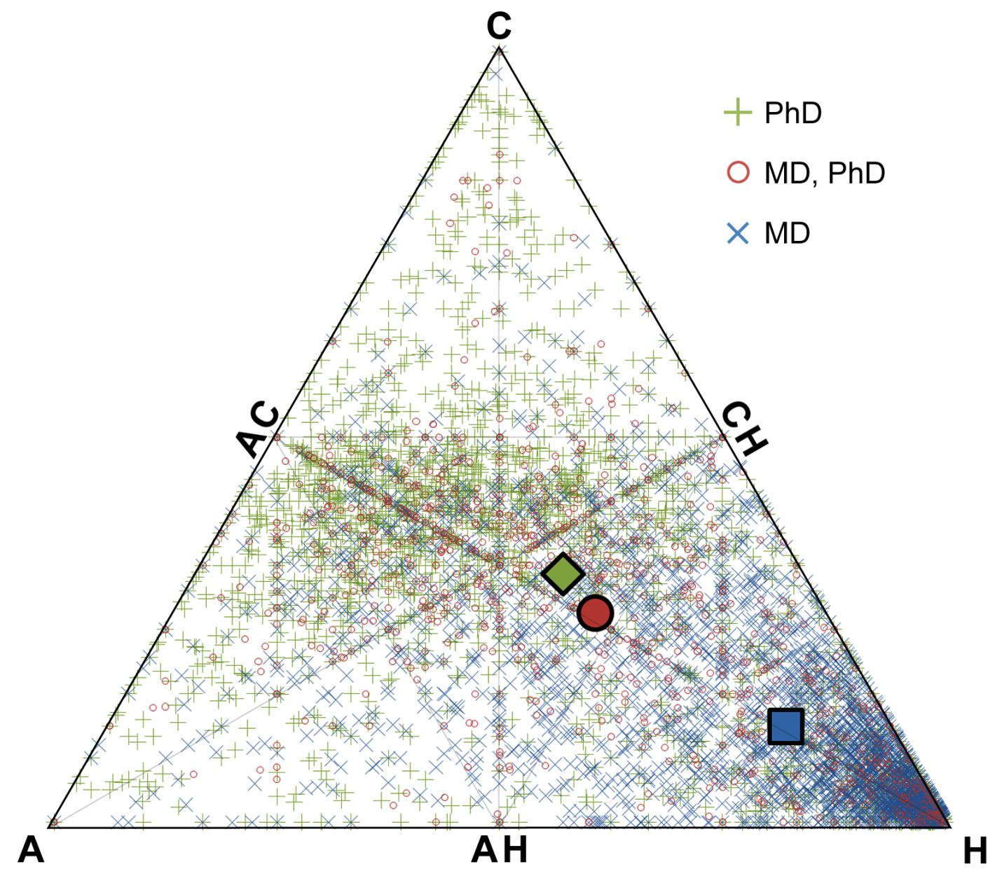
Triangle of
Biomedicine
“C”: Cells & Molecules
“A”: Animals
“H”: Humans
Individual
Investigators
Weber GM. Identifying translational science within the triangle of biomedicine. J Transl Med. 2013 May 24;11:126.

Slide 6
I Need Your Help
NSF Grant: “Identifying Cross-Disciplinary Pathways to Translational Science”
How does research and researchers outside biomedicine influence human health?
Access to Scopus raw data (50 million articles)!
If interested in collaborating, contact:
Griffin M Weber, MD, PhD
weber@hms.harvard.edu

